Slide 1
Hypothesis Testing
Is It Significant?

Slide 2
Questions
What is a statistical hypothesis?
What is the null hypothesis? Why is it important for statistical tests?
Describe the steps in a test of the null hypothesis.
What are the four kinds of outcome of a statistical test (compare the sample result to the state in the population)?

Slide 3
More questions
What is statistical power?
What are the factors that influence the power of a test?
Give a concrete example of a study (describe the IV and DV) and state one thing you could do to increase its power.

Slide 4
Decision Making Under Uncertainty
You have to make decisions even when you are unsure. School, marriage, therapy, jobs, whatever.
Statistics provides an approach to decision making under uncertainty. Sort of decision making by choosing the same way you would bet. Maximize expected utility (subjective value).
Comes from agronomy, where they were trying to decide what strain to plant.

Slide 5
Statistics as a Decision Aid
Because of uncertainty (have to estimate things), we will be wrong sometimes.
The point is to be thoughtful about it; how many errors of what kinds? What are the consequences?
Statistics allows us to calculate probabilities and to base our decisions on those. We choose (at least partially) the amount and kind of error.
Hypothesis testing done mostly by convention, but there is a logic to it.

Slide 6



Statistical Hypotheses
Statements about characteristics of populations, denoted H:
  H: normal distribution,
  H: N(28,13)
The hypothesis actually tested is called the null hypothesis, H₀
  E.g.,
The other hypothesis, assumed true if the null is false, is the alternative hypothesis, H₁
  E.g.,

Slide 7
Testing Statistical Hypotheses - steps
State the null and alternative hypotheses
Assume that required to specify the (e.g., SD, normal distribution, etc.) sampling distribution of the statistic
Find rejection region of sampling distribution –that place which is not likely if null is true
Collect sample data. Find whether statistic falls inside or outside the rejection region. If statistic falls in the rejection region, result is said to be statistically significant.

Slide 8
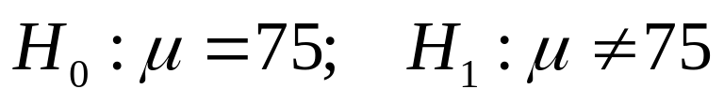

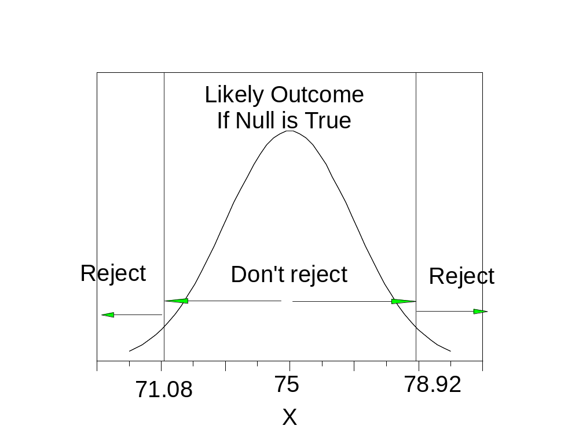
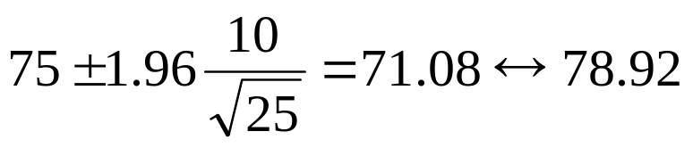
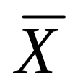

Testing Statistical Hypotheses – example
Suppose
Assume and population is normal, so sampling distribution of means is known (to be normal).
Rejection region:
Region (N=25):
We get data
Conclusion: reject null.

Slide 9
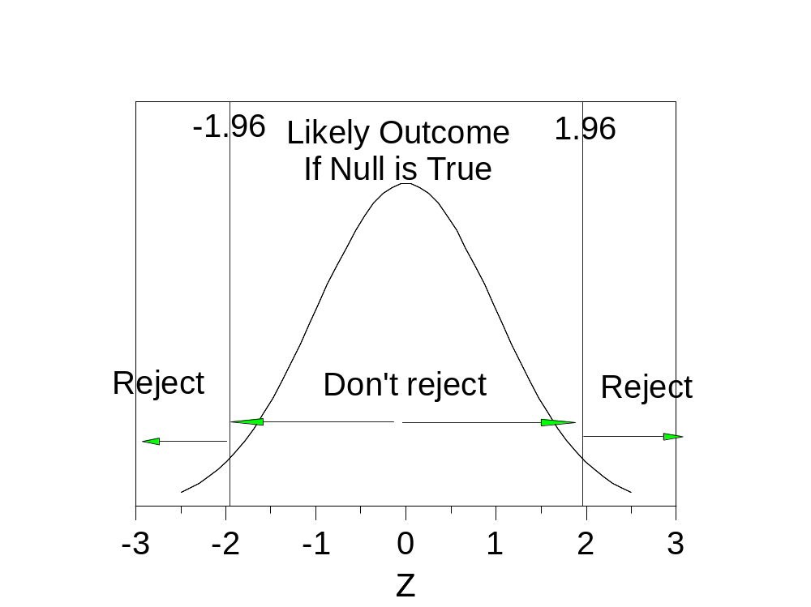
Same Example
Rejection region in z (unit normal)
Sample result (79) just over the line
Z =(79-75)/2
Z = 2
2 > 1.96

Slide 10
Review
What is a statistical hypothesis?
What is the null hypothesis? Why is it important for statistical tests?
Describe the steps in a test of the null hypothesis.

Slide 11
Decisions, Decisions
Based on the data we have, we will make a decision, e.g., whether means are different. In the population, the means are really different or really the same. We will decide if they are the same or different. We will be either correct or mistaken.
In the Population
Fire
Sample decision | Same | Different
Same | Right. Null is right, nuts. | Type II error. p(Type II)=β
Different | Type I error. p(Type I)= α | Right! Power=1-β
Fire Alarm | No | Yes
Silent | Working | Yikes!
Goes off | False Alarm | Working

Slide 12
Conventional Rules
Set alpha to .05 or .01 (some small value). Alpha sets Type I error rate.
Choose rejection region that has a probability of alpha if null is true but some bigger probability if alternative is true.
Call the result significant beyond the alpha level (e.g., p < .05) if the statistic falls in the rejection region.

Slide 13


Power (1)
Alpha ( ) sets Type I error rate. We say different, but really same.
Also have Type II errors. We say same, but really different. Power is 1- or 1-p(Type II).
It is desirable to have both a small alpha (few Type I errors) and good power (few Type II errors), but usually is a trade-off.
Need a specific H₁ to figure power.

Slide 14
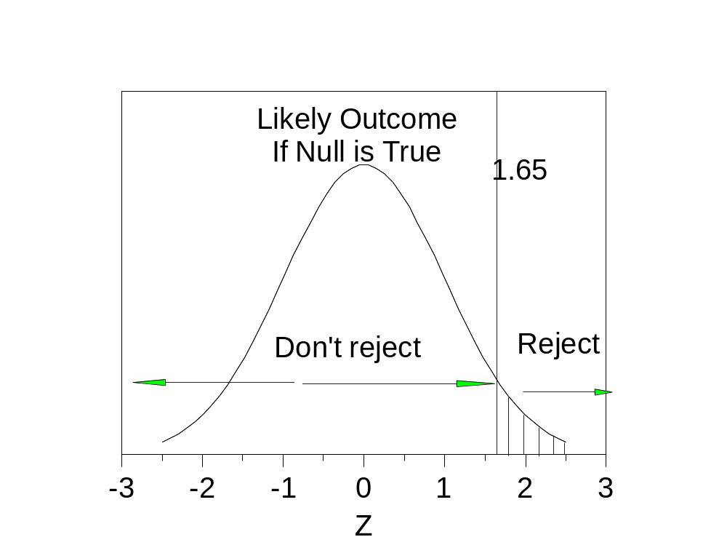
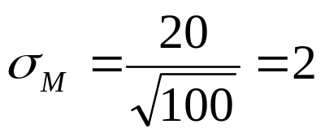

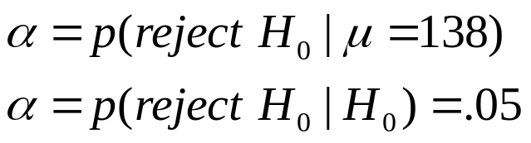
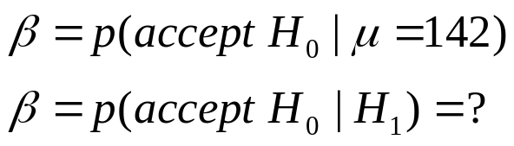
Power (2)
Suppose:
Set alpha at .05 and figure region.
Rejection region is set for alpha =.05.

Slide 15
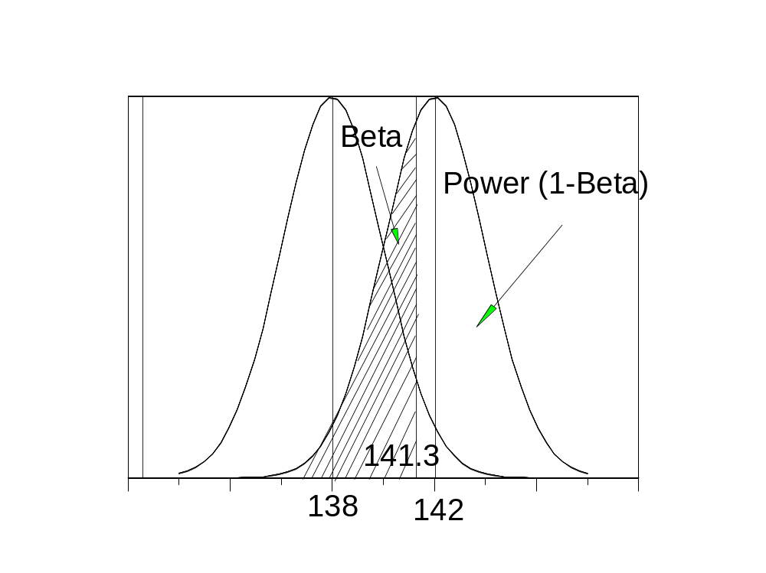
Power (3)
If the bound (141.3) was at the mean of the second distribution (142), it would cut off 50 percent and Beta and Power would be .50. In this case, the bound is a bit below the mean. It is z=(141.3-142)/2 = -.35 standard errors down. The area to the right is .36. This means that Beta is .36 and power is .64.
4 Things affect power:
H1, the alternative hypothesis.
The value and placement of rejection region.
Sample size.
Population variance.

Slide 16
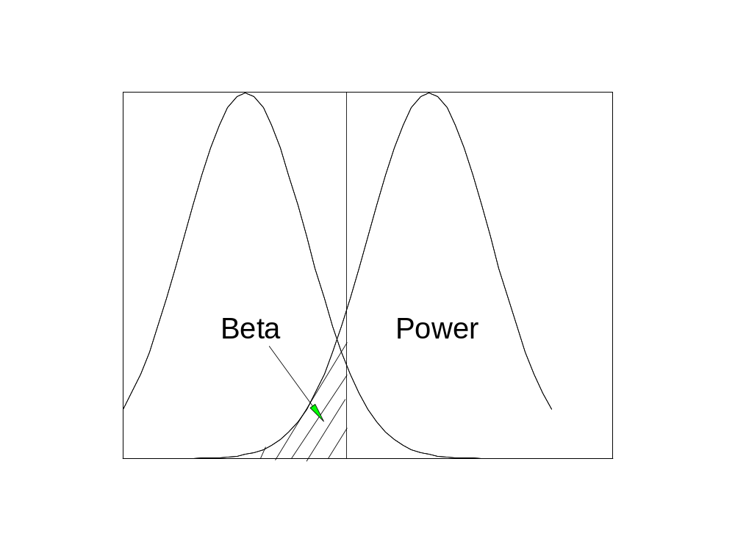
Power (4)
The larger the difference in means, the greater the power.
This illustrates the choice of H1.

Slide 17
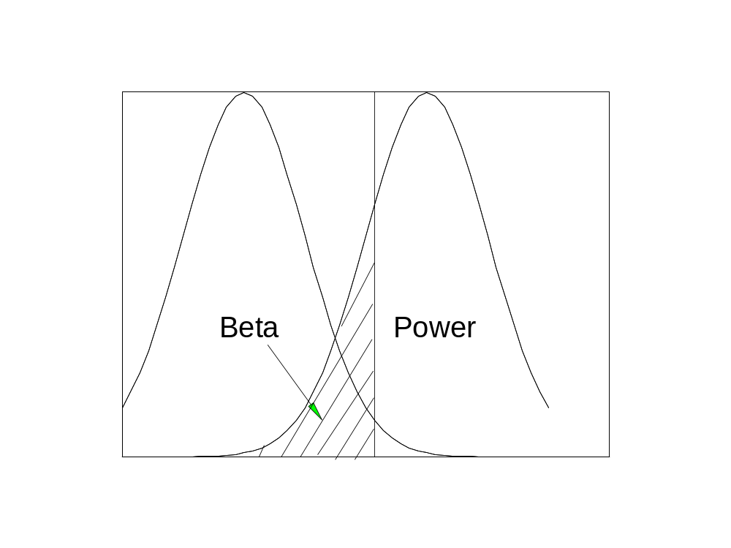
Power (5)
1 vs. 2 tails – rejection region

Slide 18
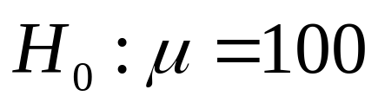



Rejection Regions
1-tailed vs. 2-tailed tests.
The alternative hypothesis tells the tale (determines the tails).
If
Nondirectional; 2-tails
Directional; 1 tail (need to adjust null for these to be LE or GE).
In practice, most tests are two-tailed. When you see a 1-tailed test, it’s usually because it wouldn’t be significant otherwise.

Slide 19
Rejection Regions (2)
1-tailed tests have better power on the hypothesized size.
1-tailed tests have worse power on the non-hypothesized side.
When in doubt, use the 2-tailed test.

Slide 20
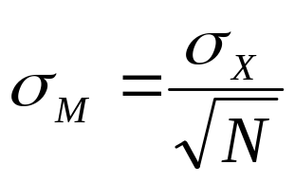
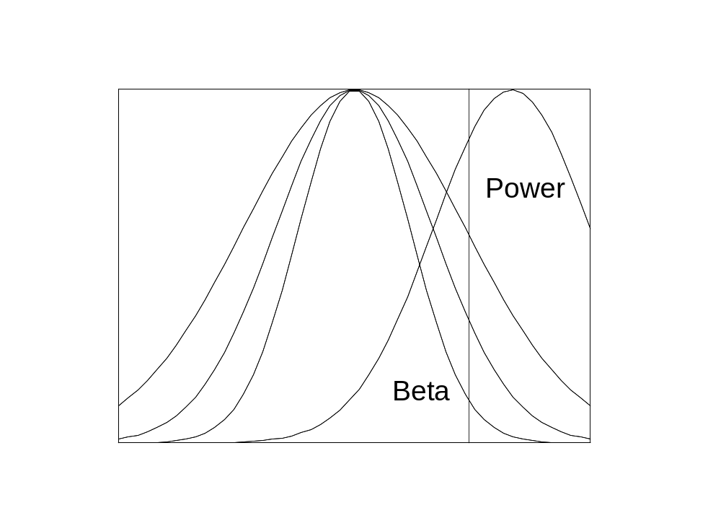
Power (6)
Sample size and population variability both affect the size of the standard error of the mean. Sample size is controlled directly. The standard deviation is influenced by experimental control and reliability of measurement.

Slide 21
Review
What are the four kinds of outcome of a statistical test (compare the sample result to the state in the population)?
What is statistical power?
What are the factors that influence the power of a test?
Give a concrete example of a study (describe the IV and DV) and state one thing you could do to increase its power.

